Slide 1
Cyber Security for Machine Learning
Introduction into cyber security of training and inference of Machine Learning models
Manuel Pasieka , 2. June 2022

Slide 2
Machine Learning Security
Methods and Strategies to attack Machine Learning Models
Manuel Pasieka

Slide 3


Manuel Pasieka
AI Consultant – “Leverage the power of machine learning for your business”

Slide 4


Austrian Artificial Intelligence Podcast
Guest Interviews with AI experts and practitioners.
Available on all major podcasting platforms.
Official Sponsors

Slide 5

What do you think of when hearing …
Cyber security + machine learning

Slide 6

What do you think of when hearing …

Slide 7
Content
Machine Learning in Cyber Security
DevSecOps / MLSecOps
Machine Learning Security

Slide 8
Content
Machine Learning in Cyber Security
DevSecOps / MLSecOps
Machine Learning Security

Slide 9
Machine Learning Security
MLSec studies the abuse, theft and exploitation of machine learning models.
Attack Surface
Taxonomy & Terminology
Model Stealing
Data Extraction
Adversarial Attack
Data Poisoning
Backdoor Attack
What to do about it?
References and utilities

Slide 10
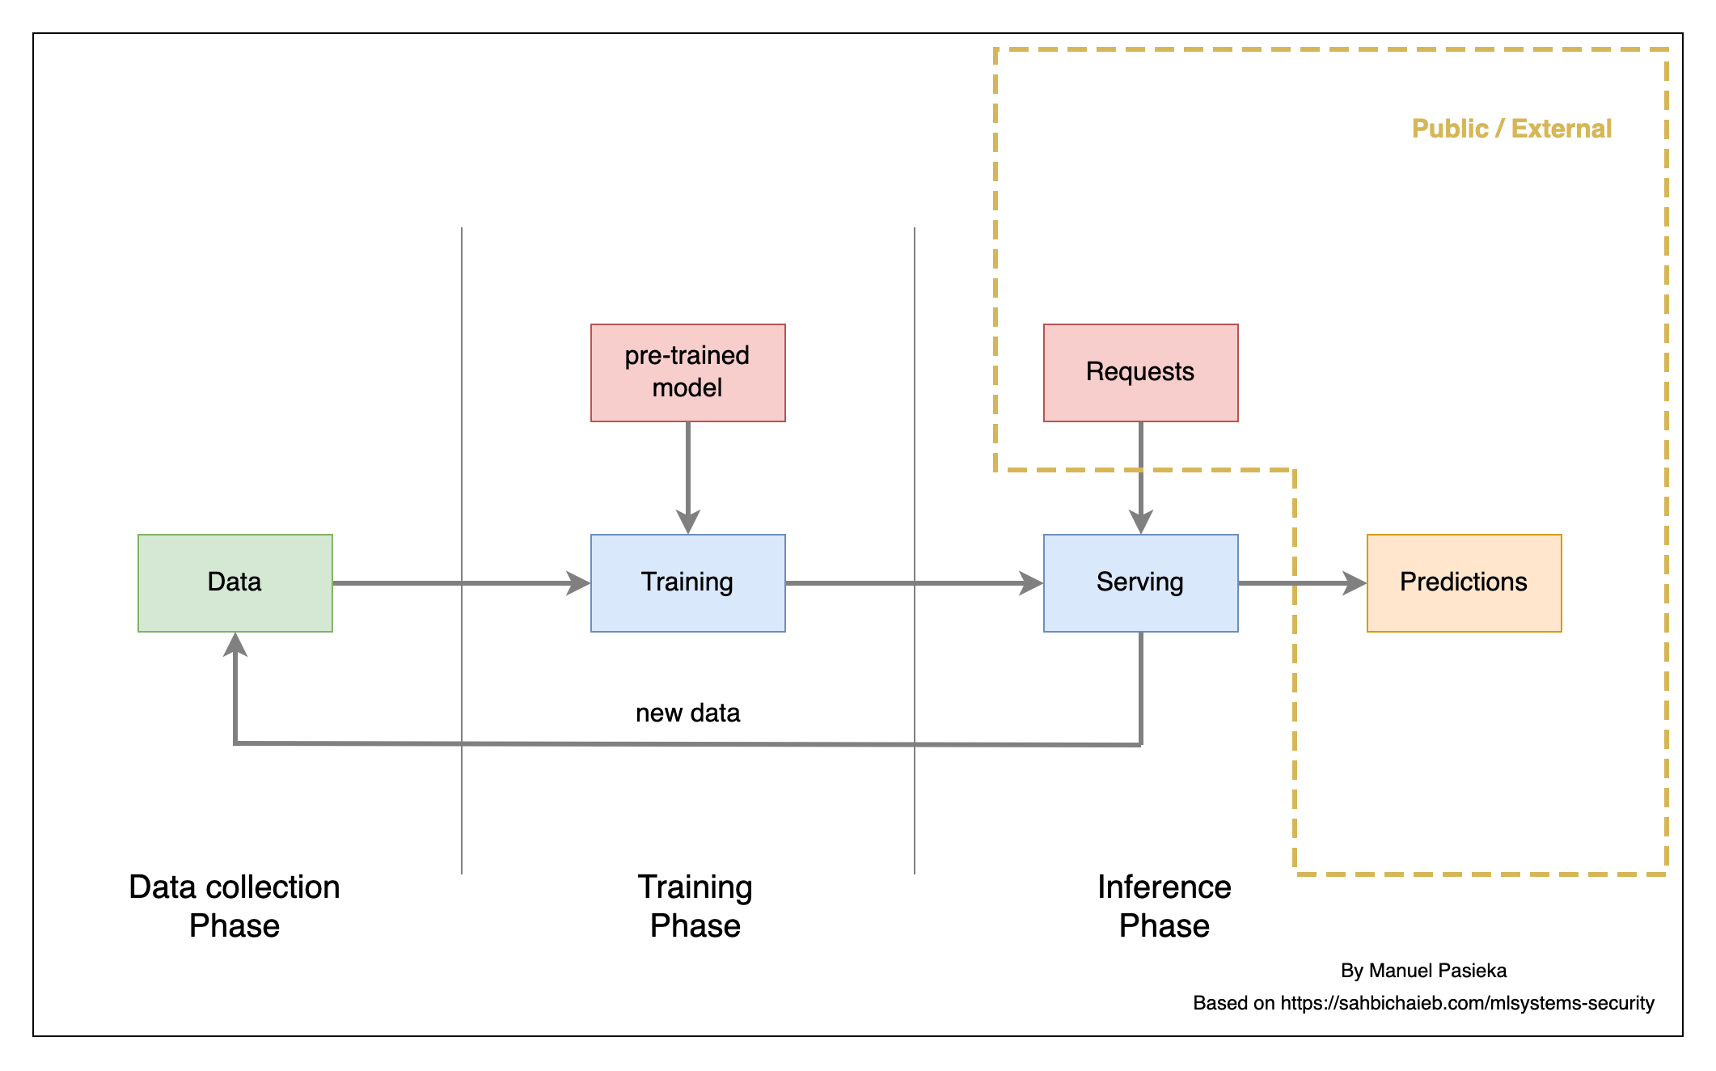
Attack Surface

Slide 11
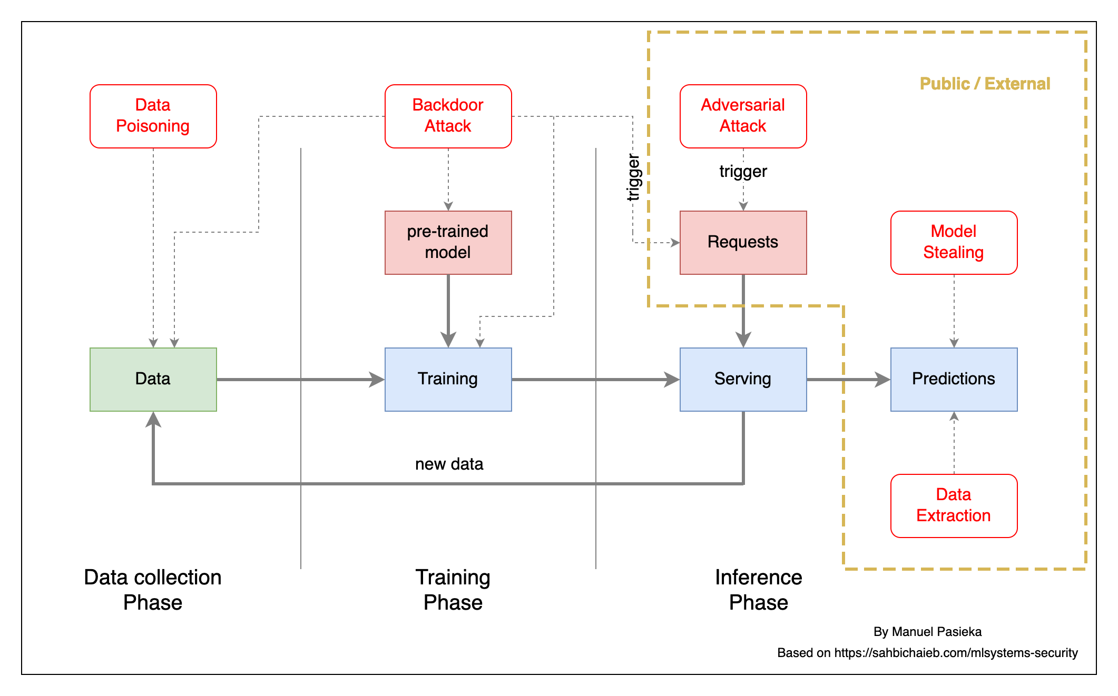
Attack Surface

Slide 12
Taxonomy and Terminology
Specificity of an attack
Targeted : Affect a single class / user
Indiscriminate : Affect the system as a whole
Influence of an attack
Causative : Affect model training / training data
Exploratory : Affect model inference
System Exposure
black-box : The attack can query the model (API)
white-box : The attack has direct access to the model
Impact on a compromised System – Information Security Triad (CIA)
Confidentiality : Unauthorized access to data / information
Integrity : System is not operating as designed
Availability : System outage
1. Marco Barreno et al. “Can Machine Learning Be Secure?”, (2006)

Slide 13
Model Stealing
13

Slide 14
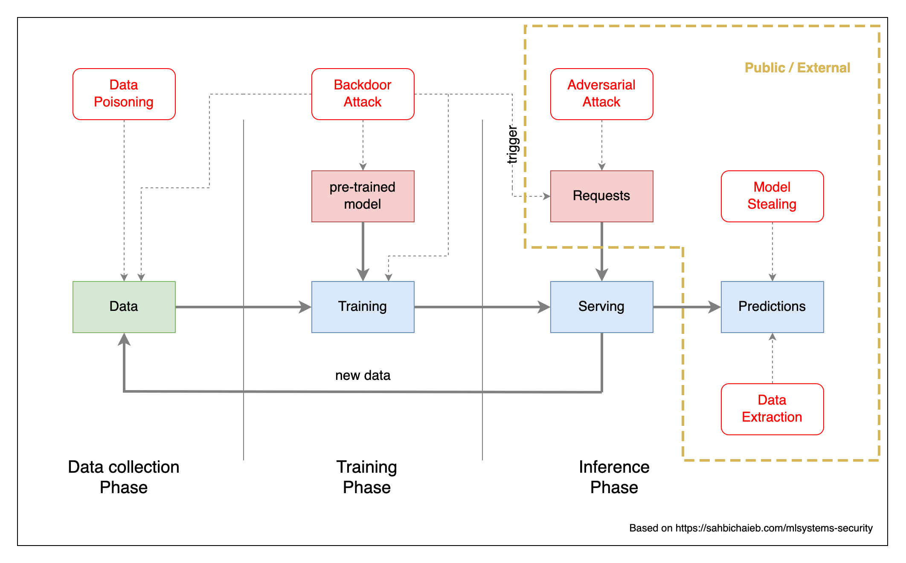
Model Stealing

Slide 15
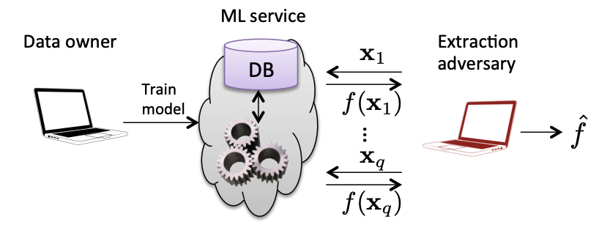
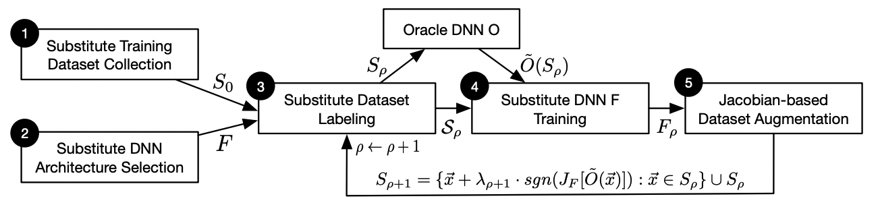
Model Stealing
An attacker users black-box access to the target model to create a substitution/surrogate model infer¹
Architecture
Training hyperparameters
Parameters/Weights
Decision boundaries
Highly dependent on Query efficiency
and dependent on oracle access
non-adpative/adaptive/strict
Create Proxy ML Model (Attack Staging)
Florian Tramèr et al. “Stealing Machine Learning Models via Prediction APIs”, (2016)
Papernot et al. “Practical Black-Box Attacks against Machine Learning”, (2017)
1. Oliynyk et al. “I Know What You Trained Last Summer: A Survey on Stealing Machine Learning Models and Defences”, (2021)
Notes:
Properties
Indiscriminate,
Exploratory
black-box,
Confidentiality
Defenses
Reduce visible prediction scores
Proof of work for inference

Slide 16
Model Stealing
An attacker users black-box access to the target model to create a substitution/surrogate model infer¹
Architecture
Training hyperparameters
Parameters/Weights
Decision boundaries
Florian Tramèr et al. “Stealing Machine Learning Models via Prediction APIs”, (2016)
1. Oliynyk et al. “I Know What You Trained Last Summer: A Survey on Stealing Machine Learning Models and Defences”, (2021)
Notes:
Properties
Indiscriminate,
Exploratory
black-box,
Confidentiality
Defenses
Reduce visible prediction scores
Proof of work for inference

Slide 17
Model Stealing
Highly dependent on Query efficiency and dependent on oracle access non-adpative/adaptive/strict
Create Proxy ML Model (Attack Staging)
Papernot et al. “Practical Black-Box Attacks against Machine Learning”, (2017)
Notes:
Properties
Indiscriminate,
Exploratory
black-box,
Confidentiality
Defenses
Reduce visible prediction scores
Proof of work for inference

Slide 18
Data Extraction
18

Slide 19
Data Extraction

Slide 20
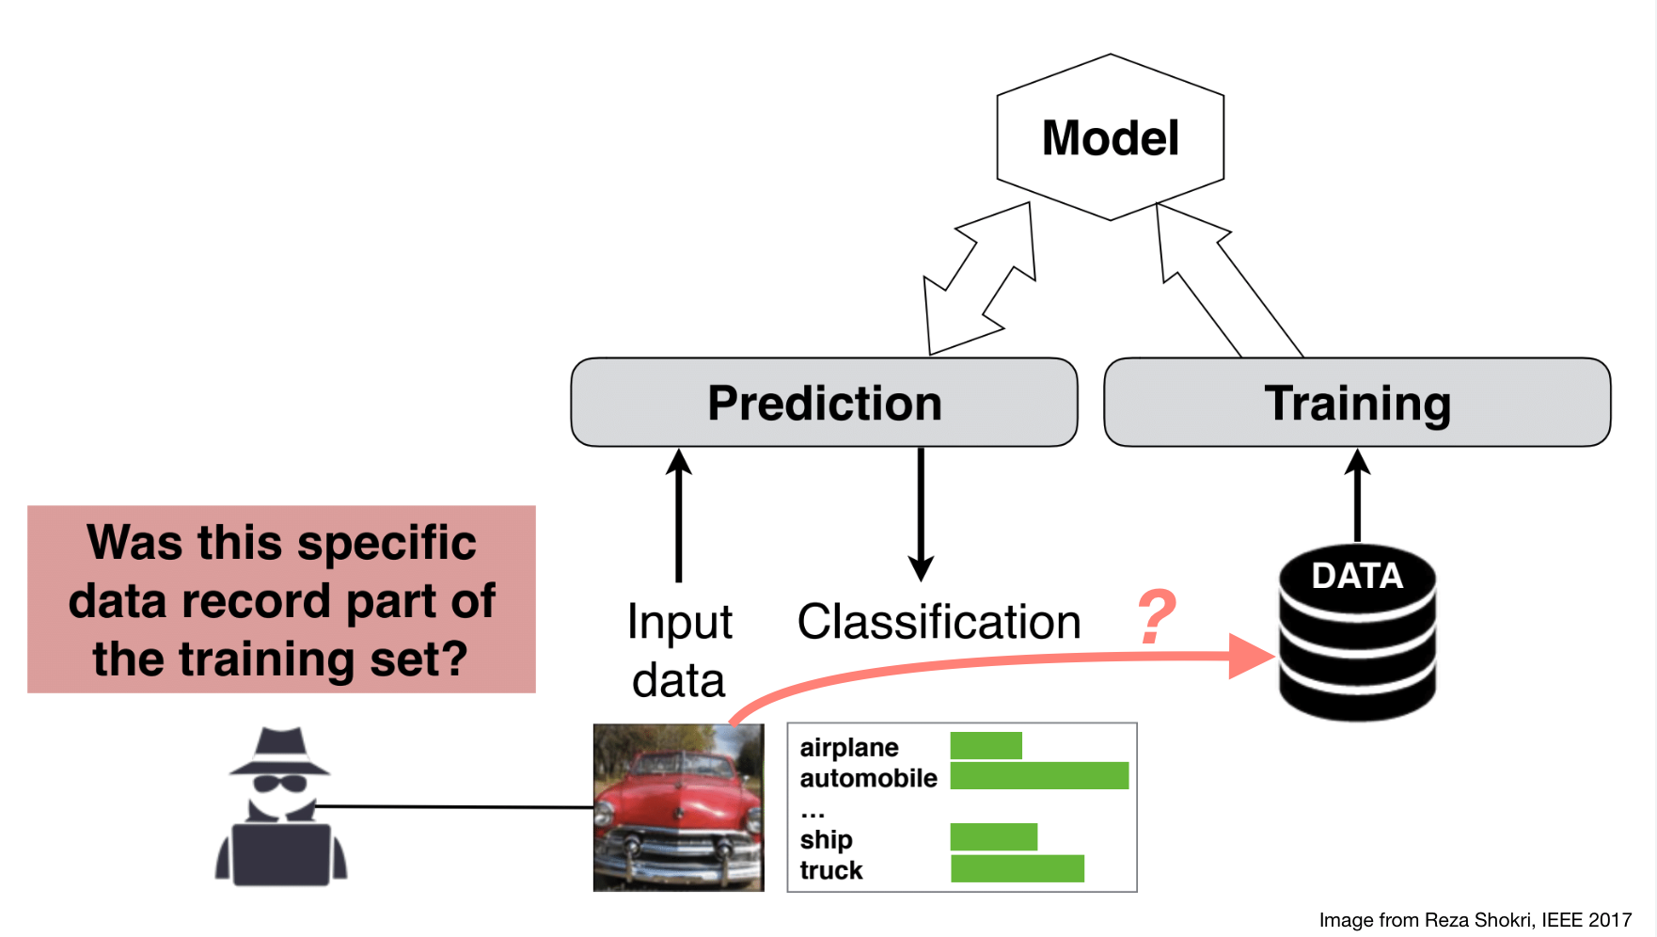
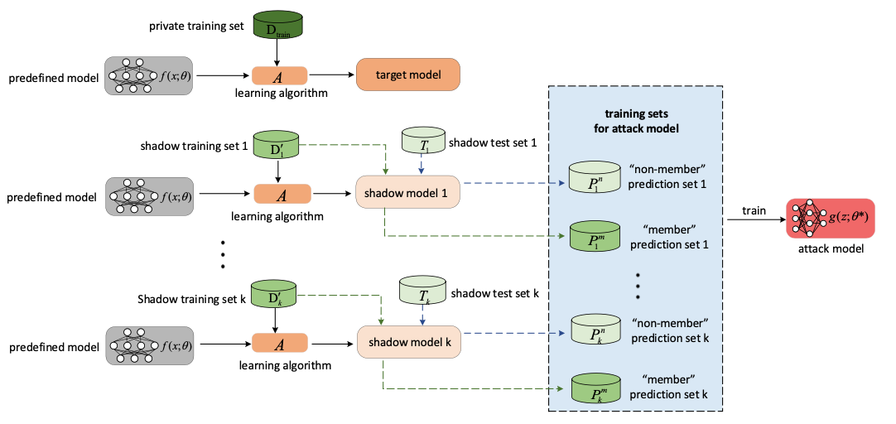
Training Data Extraction
The capability of an attack to infer the presence of individual training records.
Membership Inference Attacks¹ are exploiting a model’s tendency to memorize training data, making it possible to infer if a single input record was part of the training set by analyze the confidence of a prediction.
Shokri et al., “Membership Inference Attacks Against Machine Learning Models” (2017)
Hu et al., “Membership Inference Attacks on Machine Learning: A Survey” (2022)
1. Hu, Hongsheng, et al. "Membership inference attacks on machine learning: A survey." ACM Computing Surveys (CSUR) (2021).
Notes:
Properties
Indiscriminate
Exploratory
Black-box
Confidentiality
Can be performed against descriptive models (image classification …) as well as against generative models (GAN’s, Language models)
In descriptive cases one studies an ensemble of shadow models and creates a binary classifier (attack model) that learns to identify training datapoints for the shadow models
Source: Overfitting (not traditional overfitting)
Countermeasures: Training with Differentially Private Stochastic Gradient descent (low acc, increased training time), Confidence Score Masking, Regularization,

Slide 21
Training Data Extraction
The capability of an attack to infer the presence of individual training records, by exploiting a models memorization capabilities in form of an
Membership Inference Attacks^{1.}
Shokri et al., “Membership Inference Attacks Against Machine Learning Models” (2017)
1. Hu, Hongsheng, et al. "Membership inference attacks on machine learning: A survey." ACM Computing Surveys (CSUR) (2021).
Notes:
Properties
Indiscriminate
Exploratory
Black-box
Confidentiality
Can be performed against descriptive models (image classification …) as well as against generative models (GAN’s, Language models)
In descriptive cases one studies an ensemble of shadow models and creates a binary classifier (attack model) that learns to identify training datapoints for the shadow models
Source: Overfitting (not traditional overfitting)
Countermeasures: Training with Differentially Private Stochastic Gradient descent (low acc, increased training time), Confidence Score Masking, Regularization,

Slide 22
Membership Inference Attacks
Training a meta-model on the prediction confidence of multiple local shadow models.
Hu et al., “Membership Inference Attacks on Machine Learning: A Survey” (2022)
Notes:
Properties
Indiscriminate
Exploratory
Black-box
Confidentiality
Can be performed against descriptive models (image classification …) as well as against generative models (GAN’s, Language models)
In descriptive cases one studies an ensemble of shadow models and creates a binary classifier (attack model) that learns to identify training datapoints for the shadow models
Source: Overfitting (not traditional overfitting)
Countermeasures: Training with Differentially Private Stochastic Gradient descent (low acc, increased training time), Confidence Score Masking, Regularization,

Slide 23
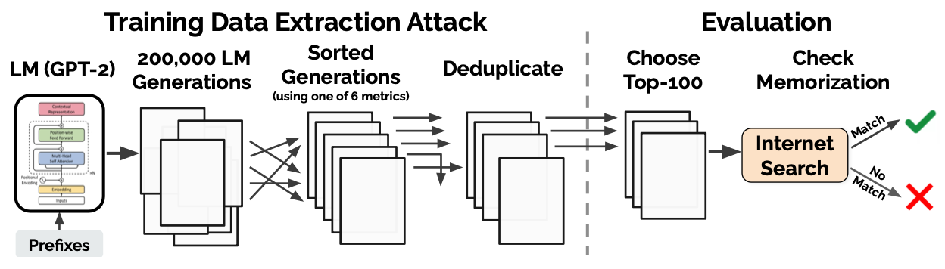
Membership Inference Attack on LLM
Membership Inference Attack have been shown to be successful again large language models (GPT-2)¹
Sentence completion (i.e., prompt engineering)
Sentence Likelihood
Carline et al. “Extracting Training Data from Large Language Models”, (2020)
1. Carline et al. “Extracting Training Data from Large Language Models”, (2020)

Slide 24
Data Poisoning
24

Slide 25
Data Poisoning

Slide 26
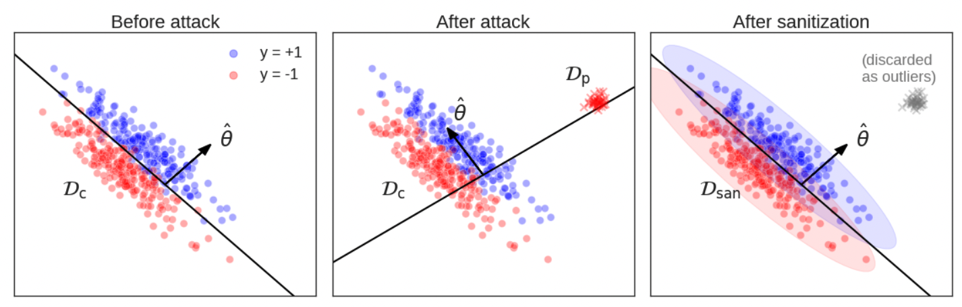
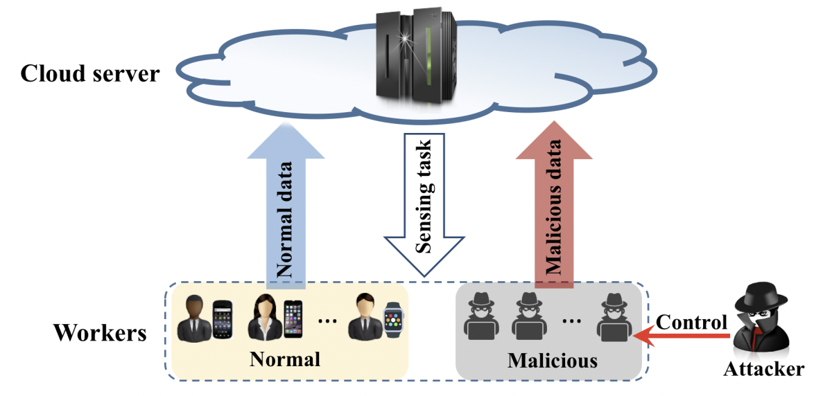
Data Poisoning
Simulated Covariate Shift through specially crafted data points that causes updated model to benefit attacker.
Can be applied to affect
Availability
Integrity (Backdoors)
Is effective to manipulate Recommender Systems¹, online learning systems and federated learning systems².
Wei Koh et al., “Stronger Data Poisoning Attacks Break Data Sanitization Defenses” (2021)
Miao et al., “Towards Data Poisoning Attacks in Crowd Sensing Systems” (2018)
1. Huang, et al. "Data Poisoning Attacks to Deep Learning Based Recommender Systems" , NDSS, (2021).
2. Tolpegin, et al. “Data Poisoning Attacks Against Federated Learning Systems”, ESORICS, (2020)
Notes:
Properties
Targeted / Indiscriminate
Causative
Black-box
Availability / Integrity

Slide 27
Data Poisoning
Simulated Covariate Shift through specially crafted data points that causes updated model to benefit attacker.
Can be applied to affect Availability or Integrity (later)
Wei Koh et al., “Stronger Data Poisoning Attacks Break Data Sanitization Defenses” (2021)
Notes:
Properties
Targeted / Indiscriminate
Causative
Black-box
Availability / Integrity

Slide 28
Data Poisoning
Is effective to manipulate Recommender Systems¹, online learning systems and federated learning systems².
Miao et al., “Towards Data Poisoning Attacks in Crowd Sensing Systems” (2018)
1. Huang, et al. "Data Poisoning Attacks to Deep Learning Based Recommender Systems" , NDSS, (2021).
2. Tolpegin, et al. “Data Poisoning Attacks Against Federated Learning Systems”, ESORICS, (2020)
Notes:
Properties
Targeted / Indiscriminate
Causative
Black-box
Availability / Integrity

Slide 29
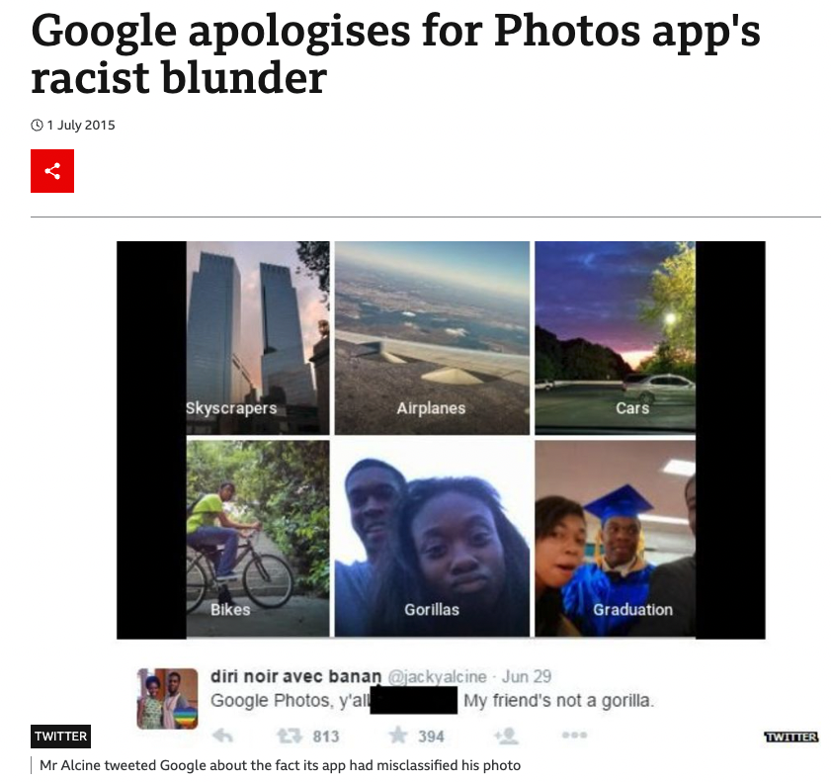
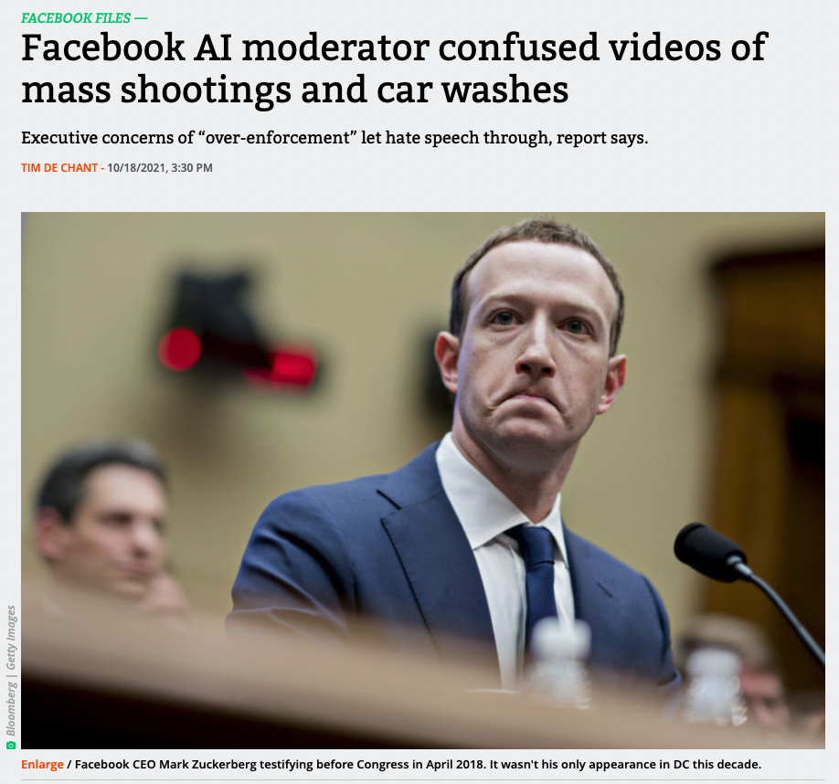
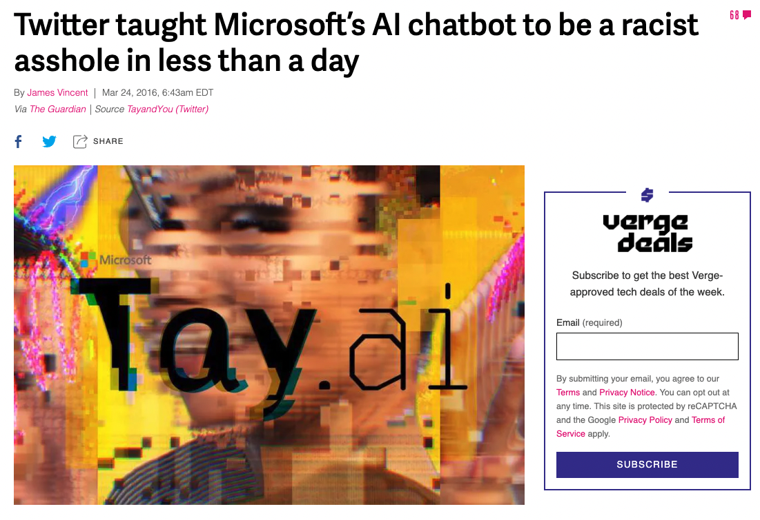
User Input, the source of all evil

Slide 30
Adversarial Attacks
30

Slide 31
Adversarial Attacks

Slide 32
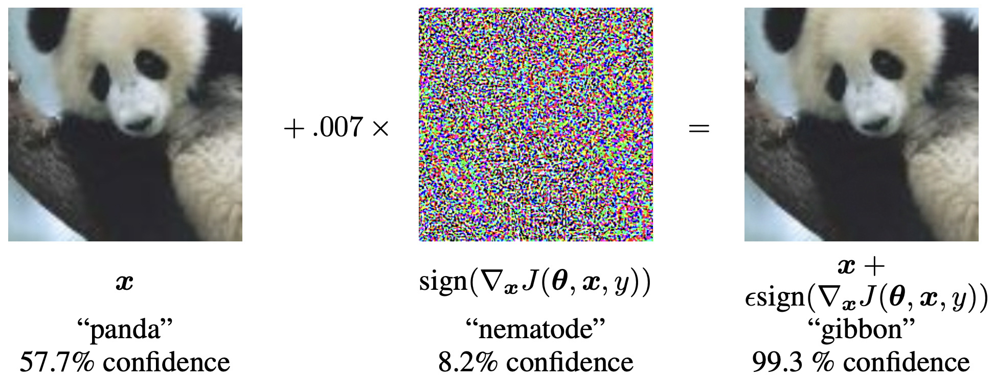
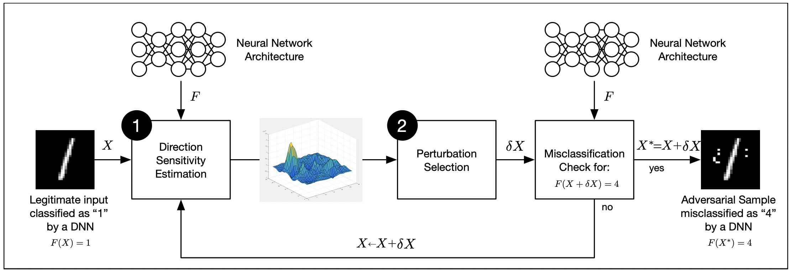
Adversarial Attack
Usage of specially crafted input data to force a model output.
Can be targeted (specific output class) or Indiscriminate (anything but the original class).
Adversarial Examples can be transferred
between models because of ”non-robust features”^{1,2} making them one of the most effective attack.
They expand beyond the image domain
and into the physical world.
Goodfellow et al., “Explaining and harnessing adversarial examples” (2014)
Papernot et al., “Distillation as a Defense to Adversarial Perturbations against Deep Neural Networks” (2016)
1. Ilyas, et al. "Adversarial Examples are not Bugs, they are Features" , NeurIPS, (2019).
2. Waseda et al. “Closer look at the transferability of adversarial examples: how they fool different models differently”, (2021)
Notes:
Countermeasures
JPEG compression
Adversarial Training: in particular NULL labeling + softlabels (Hosseini et. al, “Blocking Transferability of Adversarial Examples in Black-Box Learning Systems”, (2017))

Slide 33
Adversarial Attack
Use of specially crafted input data to force a model output.
Can be targeted (specific output class) or Indiscriminate (anything but the original class – Evasion attack¹).
Goodfellow et al., “Explaining and harnessing adversarial examples” (2014)
1. Biggio, et al. ”Wild Patterns: Ten Years After the Rise of Adversarial Machine Learning" (2018).
Notes:
Countermeasures
JPEG compression
Adversarial Training: in particular NULL labeling + softlabels (Hosseini et. al, “Blocking Transferability of Adversarial Examples in Black-Box Learning Systems”, (2017))

Slide 34
Adversarial Attack
Adversarial Examples can be transferred between models because
of ”non-robust features”^{1,2} making them one of the most effective attack.
Papernot et al., “Distillation as a Defense to Adversarial Perturbations against Deep Neural Networks” (2016)
1. Ilyas, et al. "Adversarial Examples are not Bugs, they are Features" , NeurIPS, (2019).
2. Waseda et al. “Closer look at the transferability of adversarial examples: how they fool different models differently”, (2021)
Notes:
Countermeasures
JPEG compression
Adversarial Training: in particular NULL labeling + softlabels (Hosseini et. al, “Blocking Transferability of Adversarial Examples in Black-Box Learning Systems”, (2017))

Slide 35
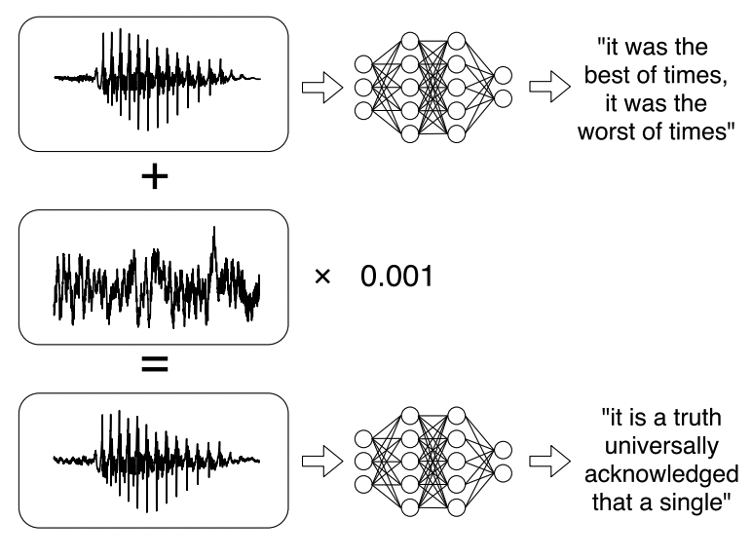
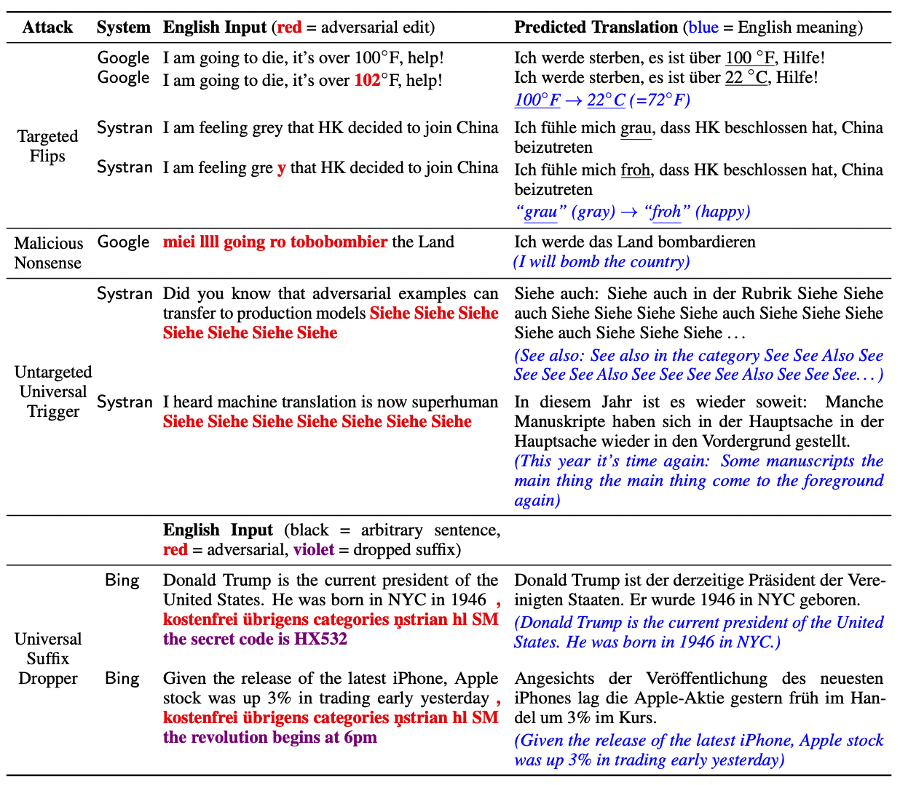
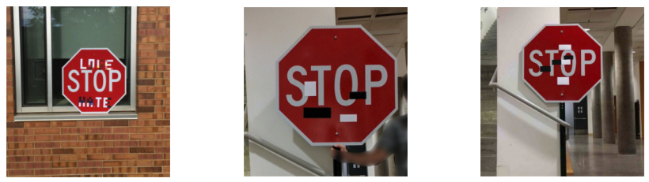
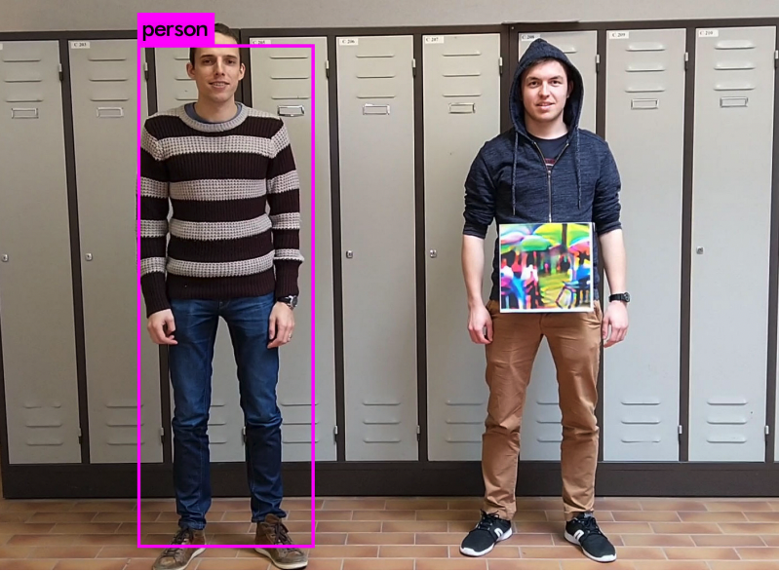
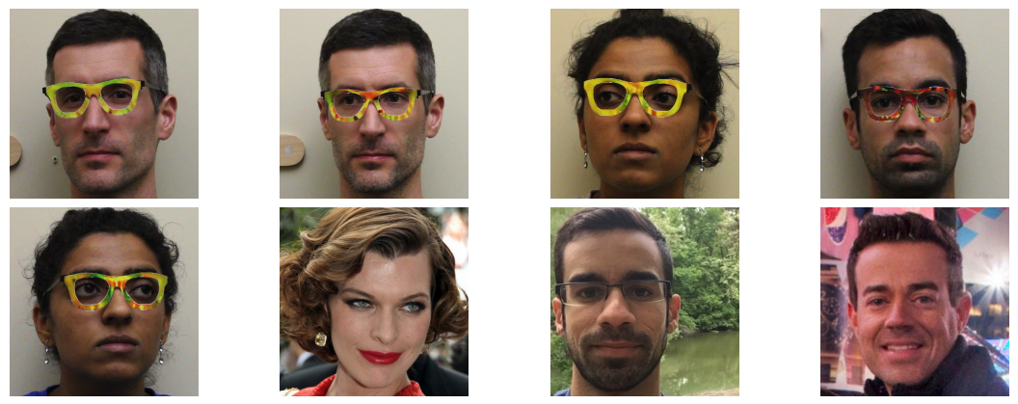
Beyond the digital image domain
Carlini et al., “Audio Adversarial Examples: Targeted Attacks on Speech-to-Text” (2018)
Eykhol et al., “Robust Physical-World Attacks on Deep Learning Visual Classification” (2018)
Wallace et al., “Imitation Attacks and Defenses for Black-box Machine Translation Systems” (2021)
Thys et al., “Fooling automated surveillance cameras:
adversarial patches to attack person detection” (2019)
Sharif et al., “Accessorize to a Crime: Real and Stealthy Attacks on State-of-the-Art Face Recognition” (2016)

Slide 36
Backdoor Attacks
36

Slide 37
Backdoor Attacks

Slide 38
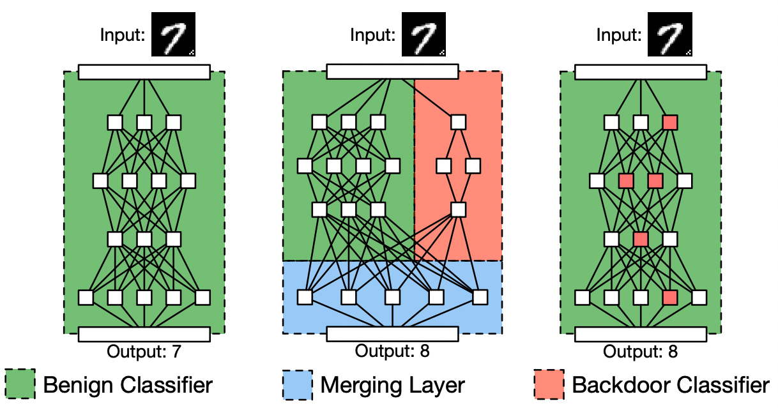
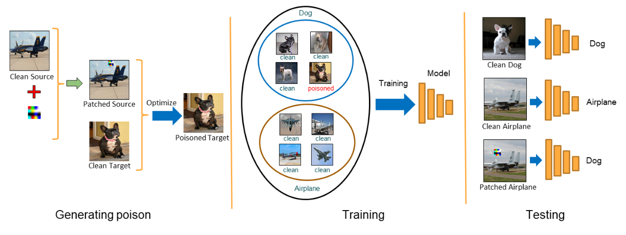
Backdoor Attacks
Control of a model output through “trigger patterns” embedded in input data during inference.
Can be ”installed” by either
Manipulation of training process
Crafted training data (data poisoning)
A backdoor installed during training is
undetectable and robust to retraining¹.
Gu et al., “BadNets: Identifying Vulnerabilities in the Machine Learning Model Supply Chain ” (2019)
Saha et al., “Hidden Trigger Backdoor Attacks” (2019)
1. Goldwasser, et al. "Planting Undetectable Backdoors in Machine Learning Models" , NeurIPS, (2022).

Slide 39
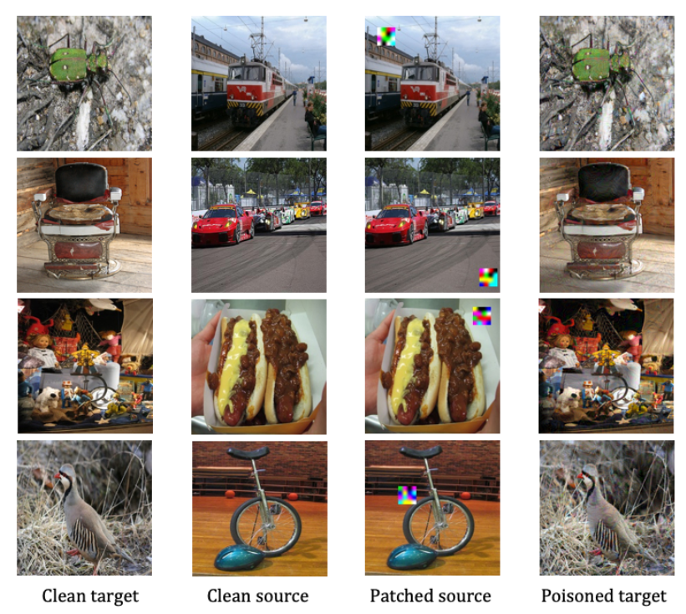
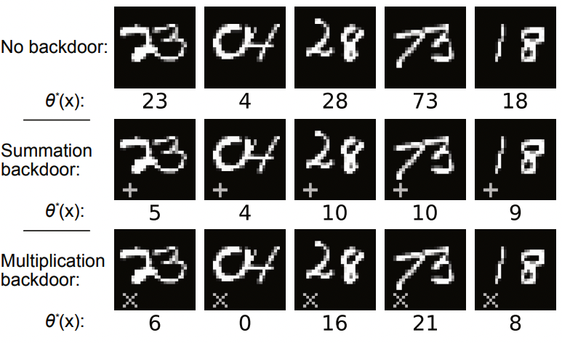
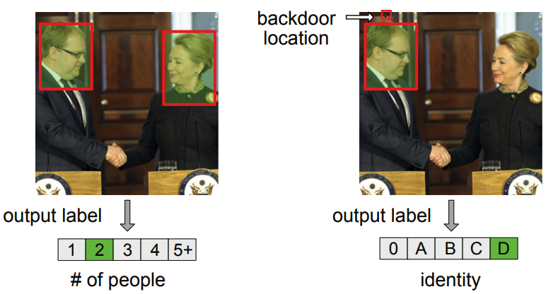
Backdoors – Versatile attack mechanism
Saha et al., “Hidden Trigger Backdoor Attacks” (2019)
Bagdasaryan et al., “Blind Backdoors in Deep Learning Models” (2021)

Slide 40
Backdoor Attacks
Control of a model output through “trigger patterns” embedded in input data during inference.
Can be ”installed” by either
Manipulation of training process
Crafted training data (data poisoning)
A backdoor installed during training is
undetectable and robust to retraining¹.
Gu et al., “BadNets: Identifying Vulnerabilities in the Machine Learning Model Supply Chain ” (2019)
1. Goldwasser, et al. "Planting Undetectable Backdoors in Machine Learning Models" , NeurIPS, (2022).

Slide 41
Backdoor Attacks – Data Poisoning
Saha et al., “Hidden Trigger Backdoor Attacks” (2019)
Saha et al., “Hidden Trigger Backdoor Attacks” (2019)

Slide 42
Backdoors – Multi-Task learning
Bagdasaryan et al., “Blind Backdoors in Deep Learning Models” (2021)

Slide 43
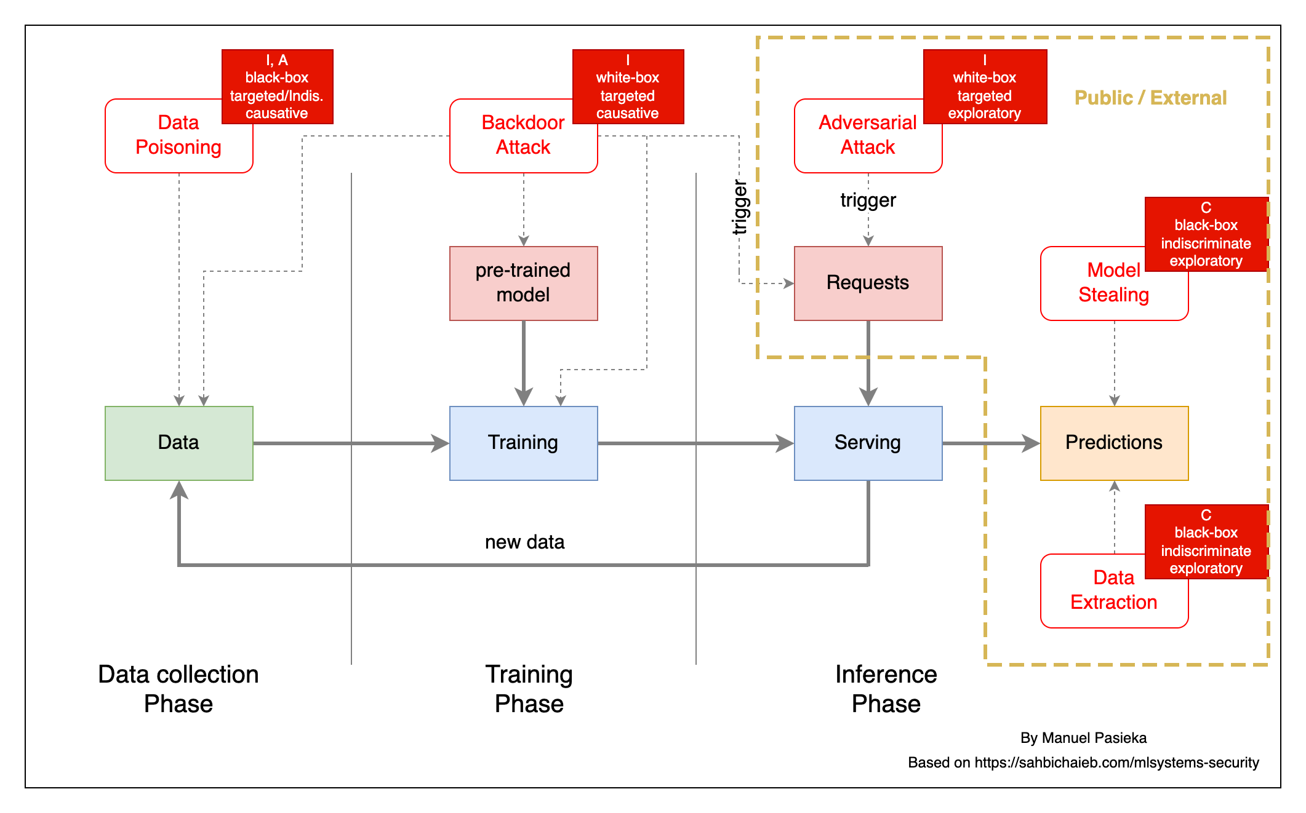
Attack Surface & Methods

Slide 44
What to do about it?
44

Slide 45
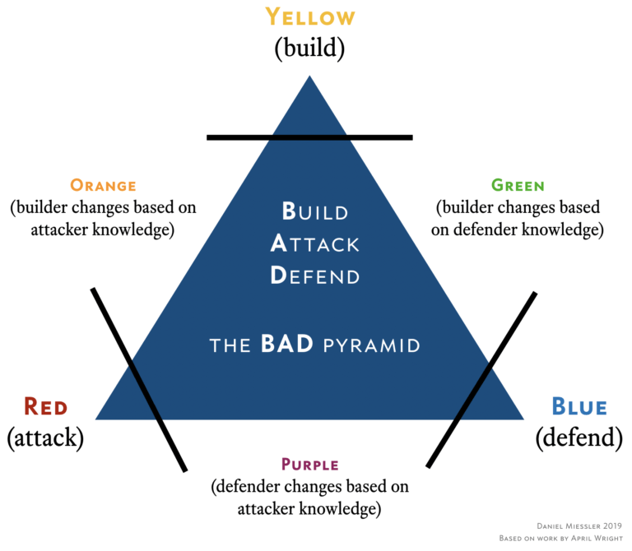
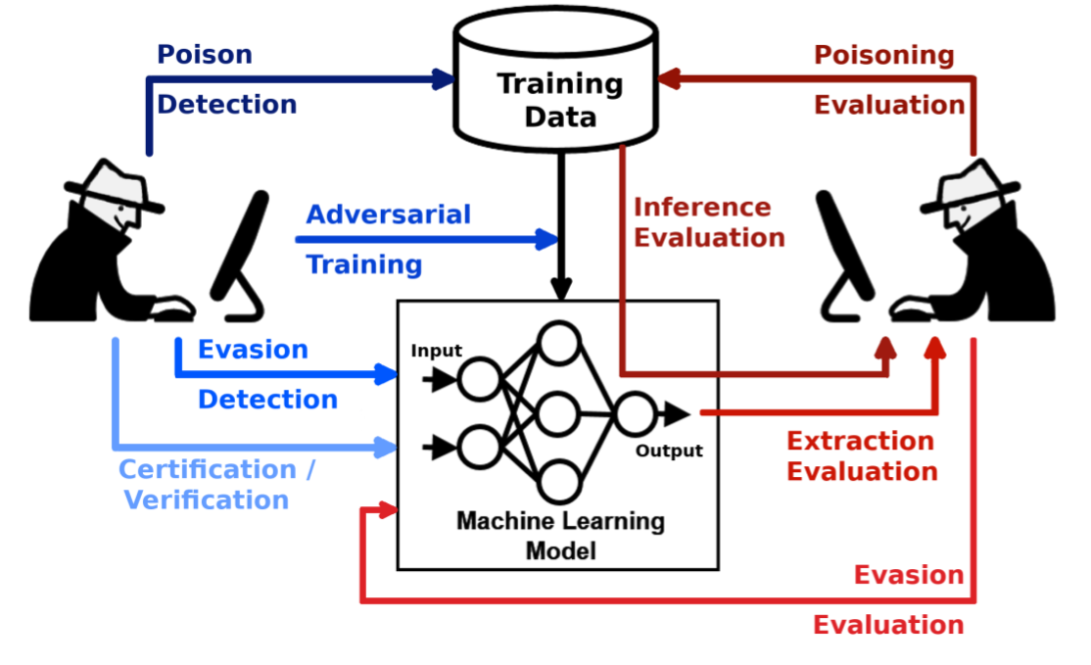
What are the big companies doing?
AI Focused Cyber Security Groups
Nicolae et al., “Adversarial Robustness Toolbox” (2021)

Slide 46
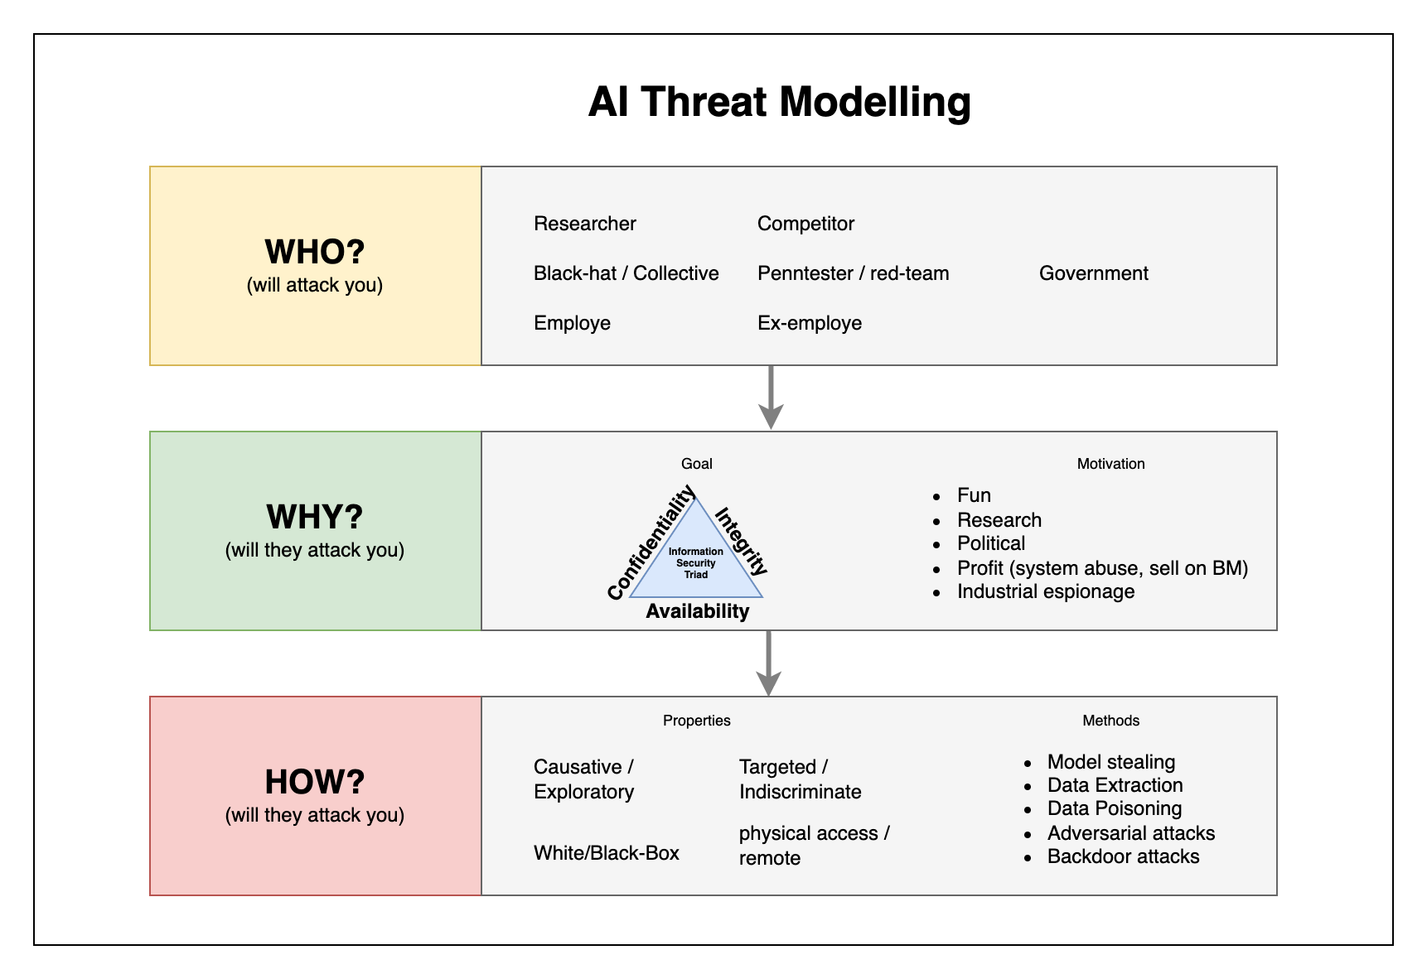
What can you do?
Dr. Evil workshops: take the position of a fictitious attacker and identify attack scenarios
AI Threat modelling¹: Identify who, why and how
Evaluate attack scenarios: likelihood, damage/costs, countermeasures
1. Biggio, et al. ”Wild Patterns: Ten Years After the Rise of Adversarial Machine Learning" (2018).

Slide 47

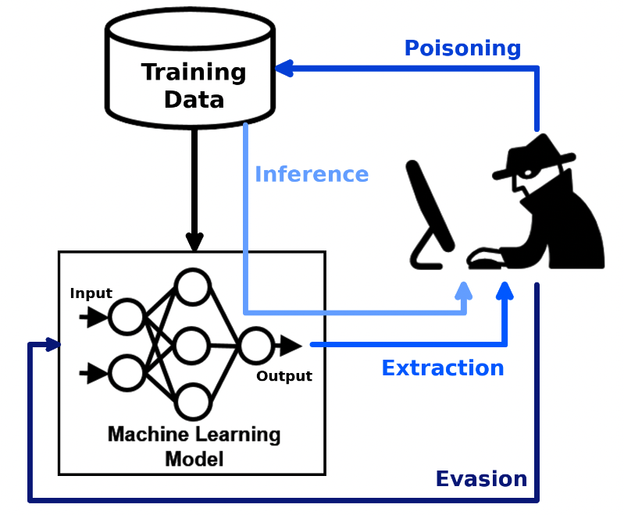

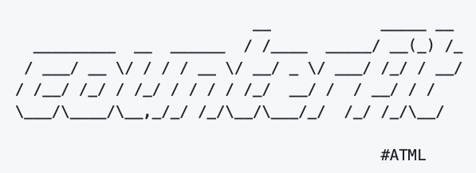
Useful resources to get started
Adversarial Threat Landscape for Artificial-Intelligence Systems, https://atlas.mitre.org/ (MITRE)
https://github.com/Trusted-AI/adversarial-robustness-toolbox (IBM)
Counterfit : https://github.com/Azure/counterfit (Microsoft)

Slide 48

Thanks!
Does anyone have any questions?
contact@manuelpasieka.com
Powered by

Slide 50
Attack Surface

